Slide 1


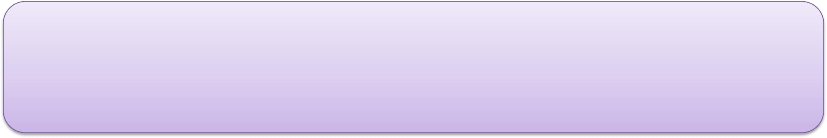
For the Degree of Bachelors of Electronics & Telecommunication Group 7
Digispex - Steps towards artificial vision
Akash Suryavanshi | Rutvik Shivalkar | Aniket Shinde | Vaibhav Shingare
Roll No: NMT 94 | Roll No:NMT 89 | Roll No:NMT 81 | Roll No:NMT 88
Guided by :
Dr Avishek Ray
(Asst Professor EXTC )
Department of Electronics & Telecommunication Engineering
K. C. College of Engineering & Management Studies & Research, Thane (E)
01/10/2021

Slide 2
OUTLINE OF PRESENTATION
OUTLINE OF PRESENTATION
Introduction
Problem Definination
Methodology
Project Objectives
Scope
Design
Data flow diagram
Conclusion
Acknowledgement
References

Slide 3
INTRODUCTION
In recent years, smart glasses have been released into the market.
Smart glasses are equipped with a see-through optical display, which is positioned in the eye-line of users . The user can view both the real-world environment and the virtual contents shown in the display, which is regarded as the concept of augmented reality.
The shift in mobile devices from smartphones to smart glasses will happen over the next decade. It is projected that smart glasses will become the next leading mobile device after the smartphone, according to market research conducted by Digi-captial . Thus, smart glasses have great potential in becoming the major platform for augmented reality.

Slide 4
METHODOLOGY
Smart- Glasses are the wearable computing device used as an extension, which can be attached to the spectacles or sunglasses of the wearer, and can be paired with Smart Phones, via Bluetooth.
This extension, contains an Arduino Micro-controller having ATmega328p microprocessor, which is programmed to connect with Smart-Phones through a Smart-phone application.
A Bluetooth module, named HC-05 is interfaced with ATmega328p, which is used to connect with smart-phones.
A battery / Re-chargeable battery of 5V is used as power supply for SmartGlass.
An SSD1306, 0.96” OLED display is interfaced with ATmega328p, which is used to display the data received from Smart-phones. Smart-Phone application is used to transmit data of the phone, i.e; Date, Time, Notifications of Phone call and Text messages

Slide 5
PROJECT OBJECTIVE
TIME
DATE/DAY
ALARM AND REMINDER
DND MODE
MISSED CALL NOTIFICATIONS
SP-02 SENSOR
BUZZER
HEART RATE SENSOR
INTERNET CONNECTIVITY

Slide 6
Scope
Navigation:
On the road, smart glasses will be able to help you find addresses, businesses, and attractions, or to stay on course when you’re on a specific route, regardless of whether you’re travelling by foot, bike, or car.
Sports and Outdoor activities:
What if you could monitor your heart rate and your oxygen saturation levels in real-time without having to check your smartphone? For runners and performance athletes across a variety of sporting activities, having the ability to keep track of the progress of their workout is probably one of the most important AR smart glasses.

Slide 7
VOLTAGE and MULTI METERS READINGS:
One of the toughest jobs for an electrician is to check the Readings of the machines without getting electrocuted when working with a heavy machinery. Hence, the smart glasses provide the Reading in the electricians vision to avoid accidents.
EMERGENCY SITUATIONS:
In today's world, can we rely on the electronic devices tonotify about the series of events happening in our day to day life which might be serious? YES WE CAN. The Smart glasses can not only notify the missed calls from another person, but also the messages from another person even if the smart phone is out of reach.

Slide 8
PROBLEM DEFINATION
The first smart glasses were invented in 2011 by Google to create an revolutionary device which has an hands free accessibility and would always be in Users vision. The drawback of this machine was it was launched without realizing the potential harm caused by the device i e just for the purpose of hype building technology that everyone will adapt with. Some drawbacks in google glasses covered by DigiSpex are:
1 DND MODE
2 MIRROR BASED VIEW
3 IS NOT LIMITED FOR USAGE BY PARTICULAR USERS

Slide 9
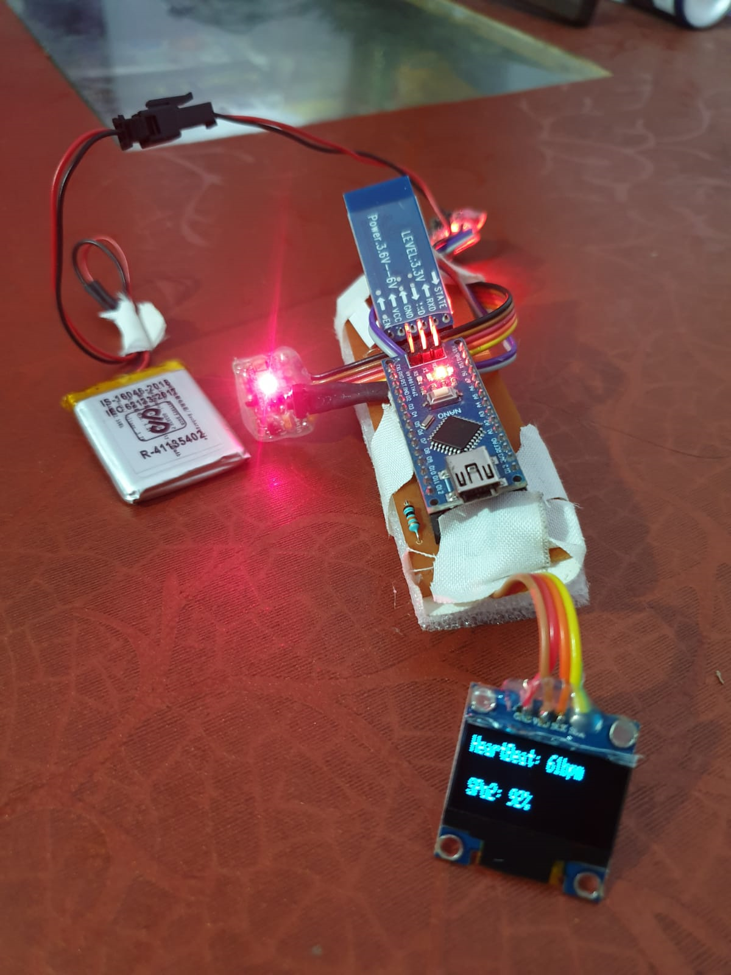
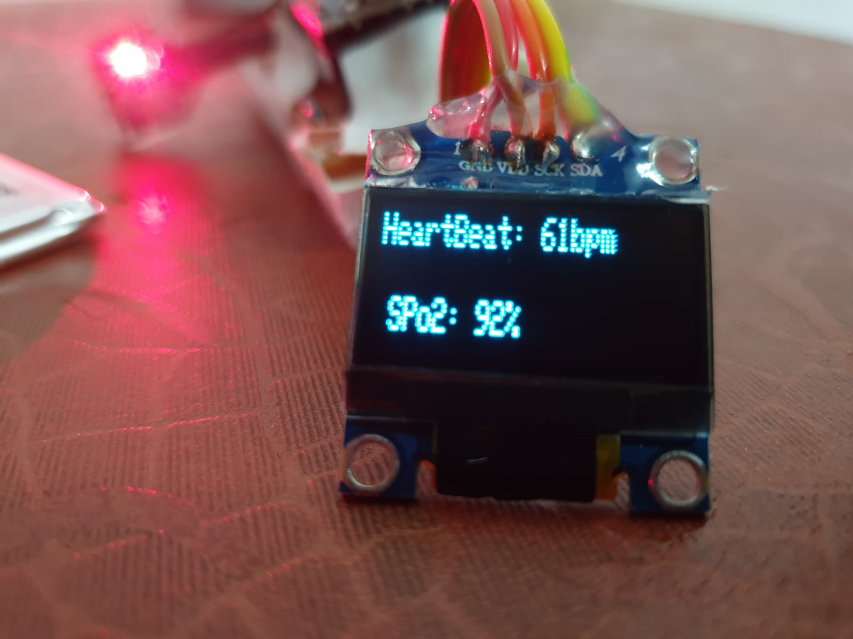
DESIGN
The design of the smart glasses is made in such a way that it feels light weight when the user wear it.

Slide 10
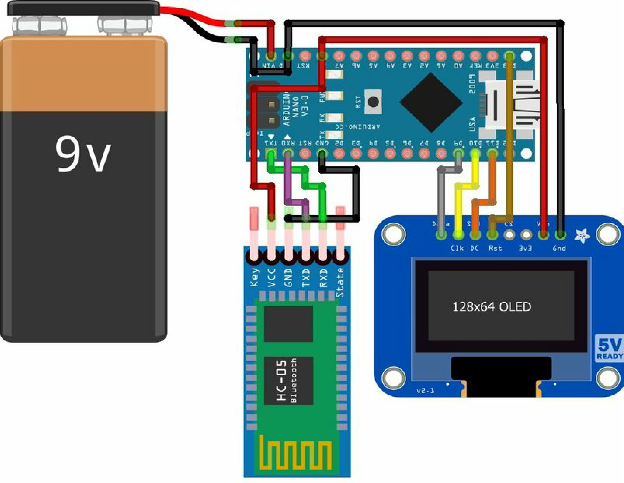
CIRCUIT DIAGRAM

Slide 11
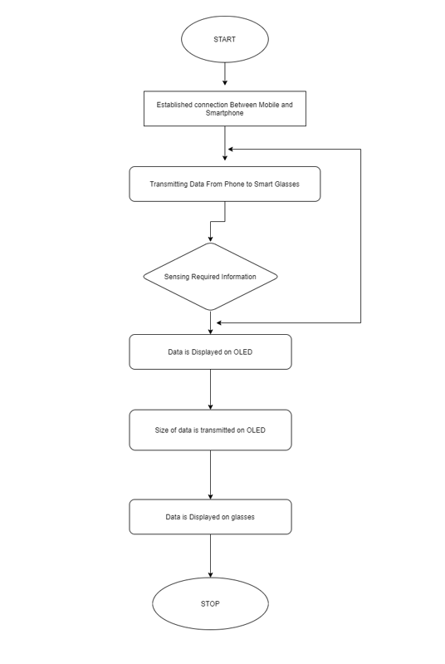
FLOW CHART

Slide 12
ACKNOWLEDGEMENTS
We would like to express our sincere thanks and deep sense of gratitude to K. C. College of Engineering & Technology and Management Studies & Research for giving us an opportunity to integrate the learning from this graduate course.
We take this opportunity to express our profound gratitude and deep regards to our guide, Head of the Electronics and Telecommunication Department, Rajiv Iyer and Guide - Dr AVISHEK RAY for his exemplary guidance, monitoring and constant encouragement throughout our project work titled “SMART NOTIFICATION DISPLAY USING OLED DIGISPECX” and also thanks to Department Faculty & Technical staff members for their time to time help for our project work.

Slide 13
CONCLUSION
The technology is increasing rapidly so there are going to be advancement in wearable computers.
Like Smart Watches the Smart Glasses are going to be the be more used accessories .
The users will be able to receive Real time notifications of their phones directly onto their regular glasses.

Slide 14
REFERENCES
Wikipedia. (2017). Magnetometer. [Online]. Available: https://en.
wikipedia.org/wiki/Magnetometer
Wikipedia. (2017). Microphone. [Online]. Available: https://en.
wikipedia.org/wiki/Microphone
D. Ashbrook, P. Baudisch, and S. White, ‘‘Nenya: Subtle and
eyes-free mobile input with a magnetically-tracked finger ring,’’ in Proc. SIGCHI Conf. Hum. Factors Comput. Syst. (CHI), New York, NY, USA, 2011, pp. 2043–2046. [Online]. Available: https://doi.org/10.1145/1978942.1979238

